Slide 1
Raleigh Neighborhoods analysis

Slide 2
Why Raleigh ?
Raleigh is one of the three hub cities comprising the Research Triangle Park (RTP) which is the largest research park in the United States.
Raleigh soared to third place in a study, regarding the best American cities to work in technology, conducted by financial news and information site SmartAsset. Given its increasing reputation as a high-tech hub, it is becoming an attractive destination for investments, also because Raleigh’s business costs are 14 percent below the national average, per Moody’s Analytics.
The downtown of Raleigh has evolved dramatically and its transformation into lively centers with high-rises and new restaurants provides great market opportunity for hotel development.
The Raleigh hotel market is divided into several different submarkets that have individual demand generators and guest profiles.
This project is aimed at determining the neighborhoods which would be optimal choices for the location for opening a new hotel based on their proximity to other venues of interest such as restaurants, attractions, etc. and where there are none or a smaller number of already existing hotels.
This analysis would be of interest to stakeholders/business owners looking to open a new hotel in the RTP area. It could also be of interest to people looking for investment in the area or hotel business.

Slide 3
Data acquisition and cleaning
The main data required for the project were extracted as follows:
Wikipedia - The list of neighborhoods for Raleigh were extracted from the Wikipedia page(https://en.wikipedia.org/wiki/Raleigh,_North_Carolina_neighborhoods).
Python Geocoder Nominatim - The location coordinates (latitude, longitude) for the neighborhoods obtained using the Python geocoder package.
latlong.net - The missing coordinates looked up using this online geographic tool.
Foursquare API (Search) - Search and extract the already existing hotels in the neighborhoods.
Foursquare API (Explore) – Explore the neighborhoods.
Duplicate entries for hotels and venues across neighborhoods were dropped.
Neighborhoods having null venue counts were dropped.

Slide 4
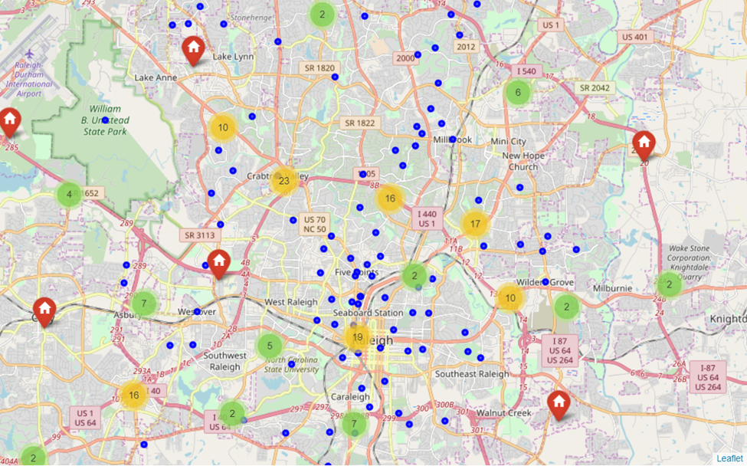
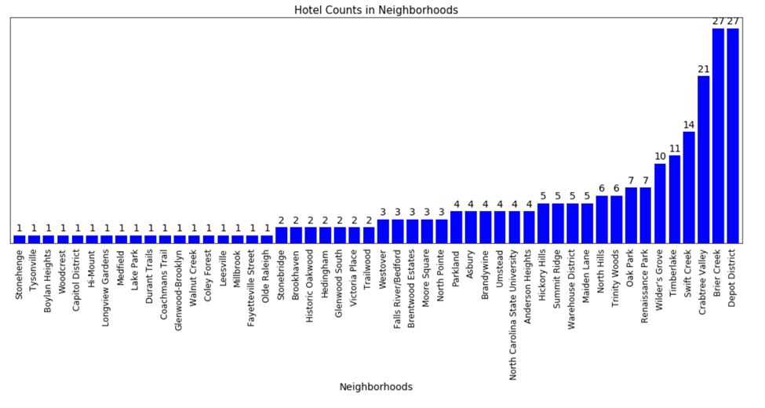
Distribution and Number of Hotels in Neighborhoods
Few regions not yet saturated with hotels. Depot District has the highest number of hotels followed by Brier Creek and Crabtree Valley.

Slide 5
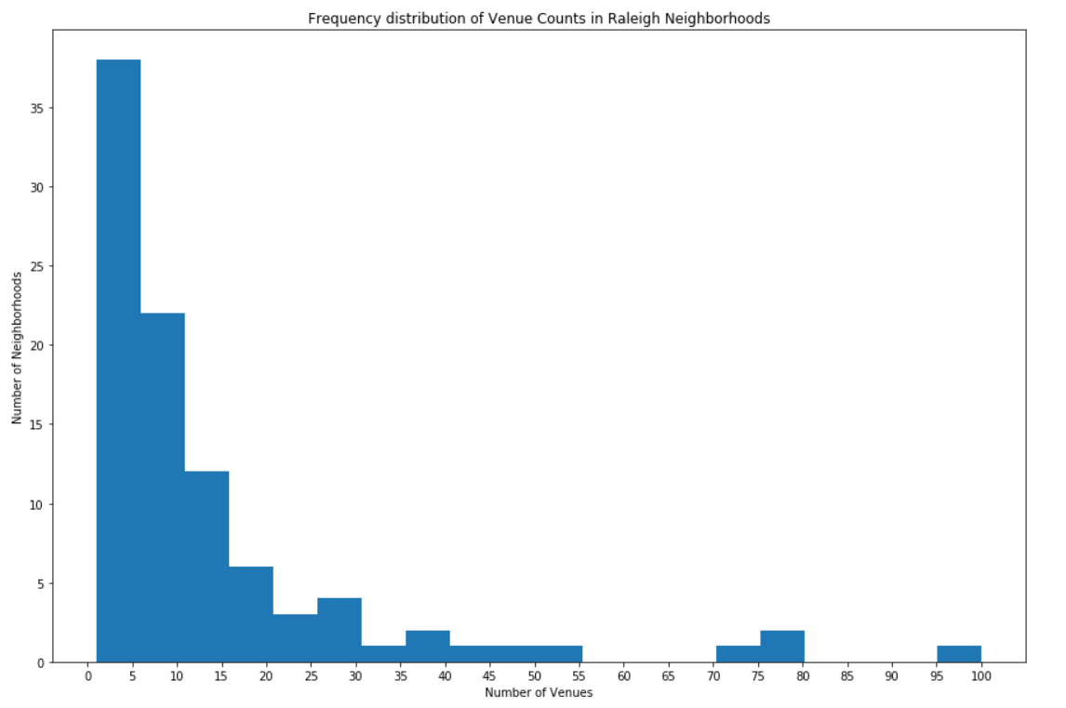
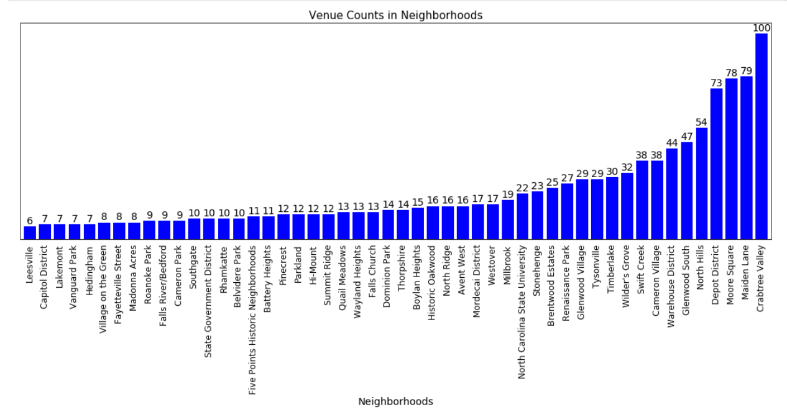
Distribution and Number of Venues in Neighborhoods
Most of the neighborhood centers have a low concentration of venues. Crabtree Valley has the highest number of venues followed by Maiden Lane, Moore Square and Depot District. Both the Crabtree Valley and the Depot District have a higher concentration of hotels as well as nearby venues.

Slide 6
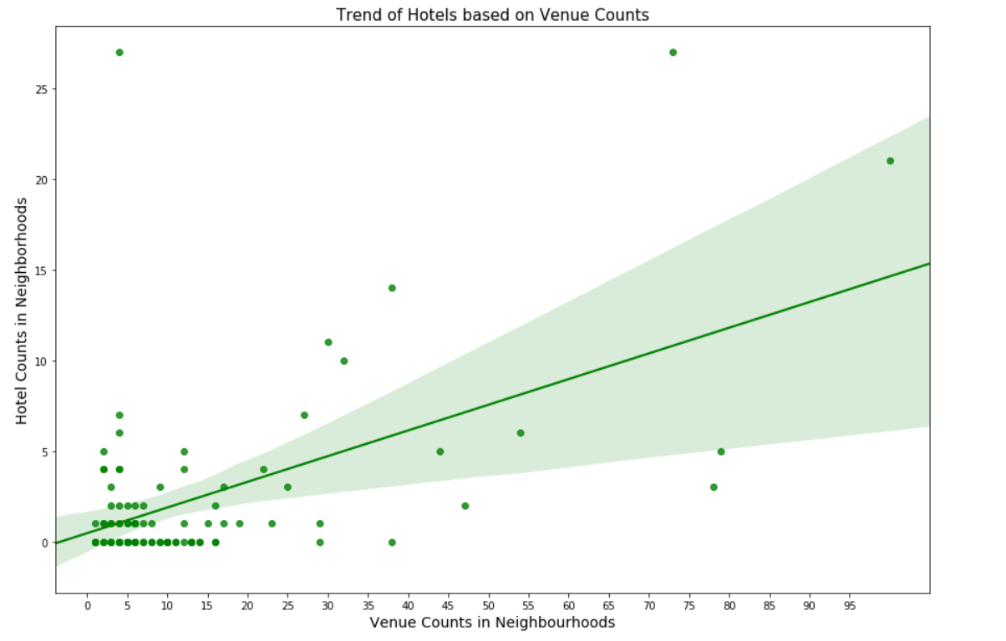
Relationship between Hotel Counts and Venues Count in Neighborhoods
There appears to be a few neighborhoods where the number of hotels is less although the number of nearby venues is more.

Slide 7
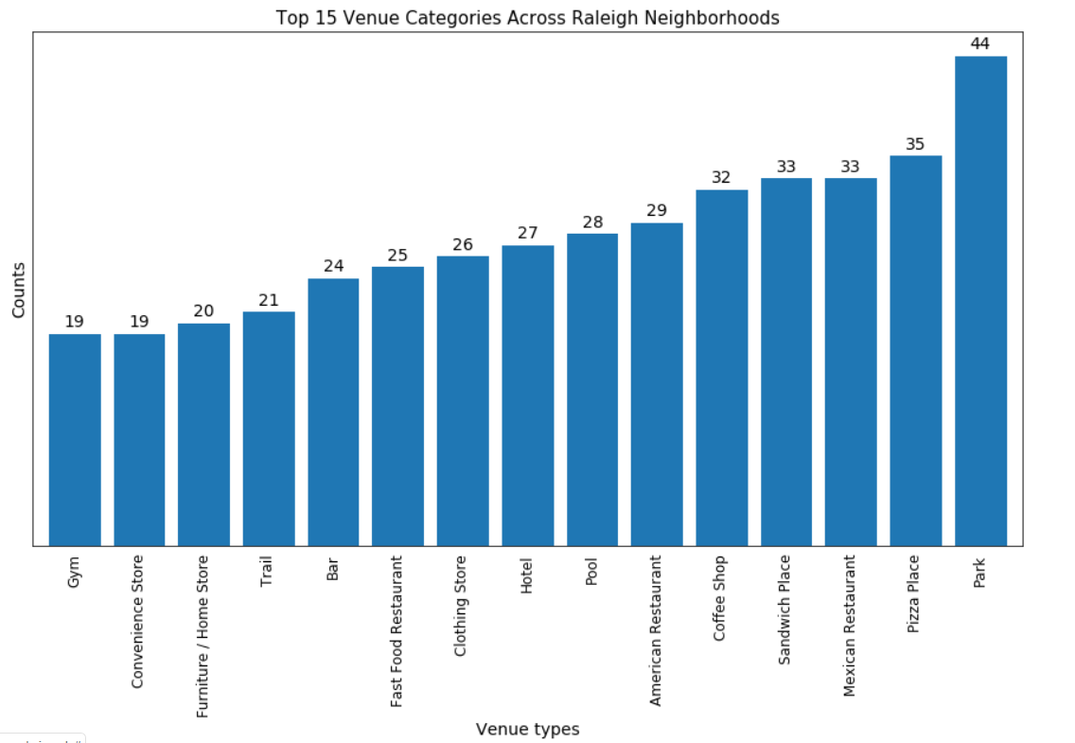
Grouping the Neighborhoods by the type of venues
This is interesting as there are not just restaurants or cafes nearby but also quite a lot of places like, park, trails, etc. for leisure activities. Since different submarkets in Raleigh have individual demand generators and guest profiles we need to find the neighborhoods based on the type of venue categories existing in them and thus we need to get the proportion being contributed by each category towards the neighborhood.

Slide 8
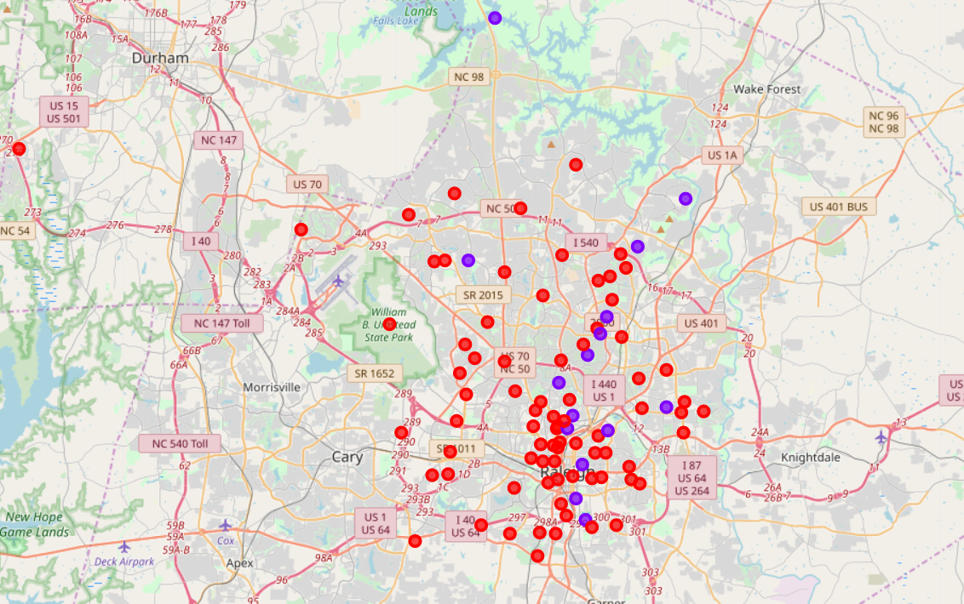
K-Means Clustering
Based on the type of venues in the neighborhoods, the number of already existing hotels and nearby venues

Slide 9
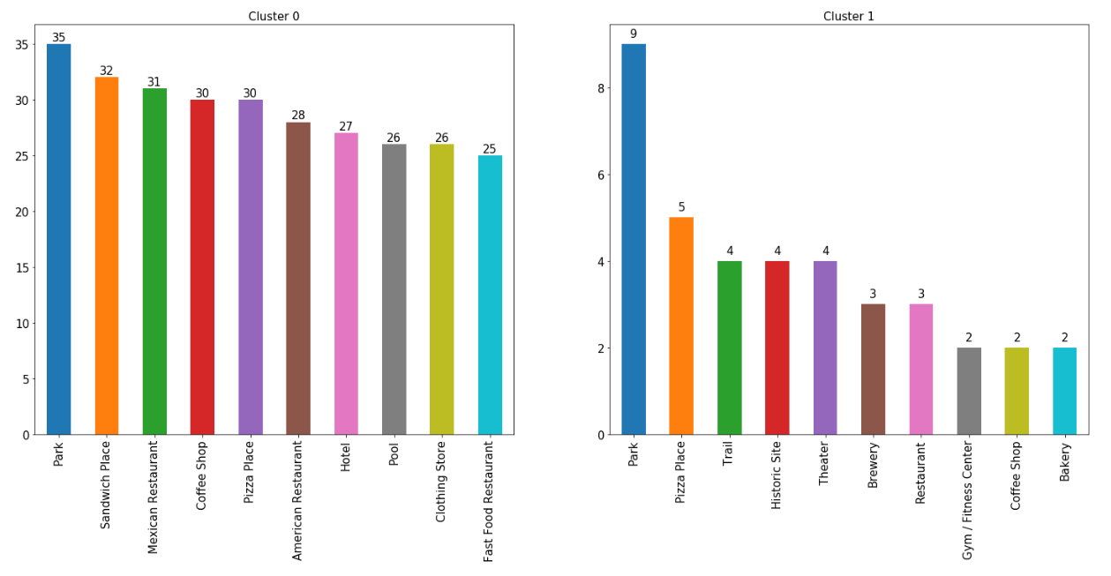
Examining Clusters (part 1)
Top ten venue categories in each cluster

Slide 10
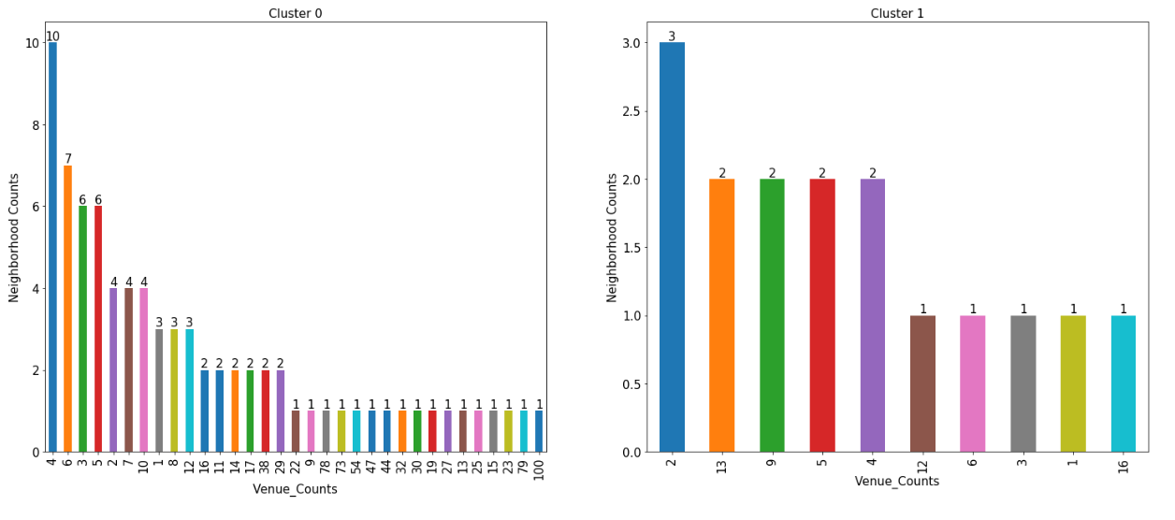
Examining Clusters (part 11)
Frequency of venue counts in each cluster

Slide 11
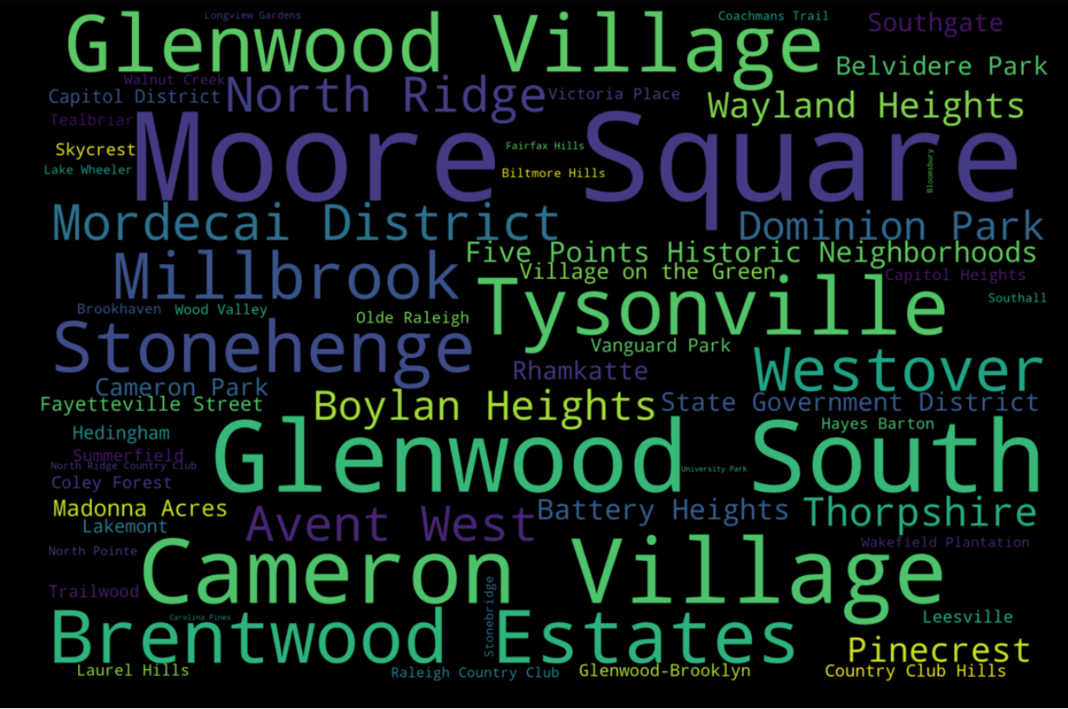
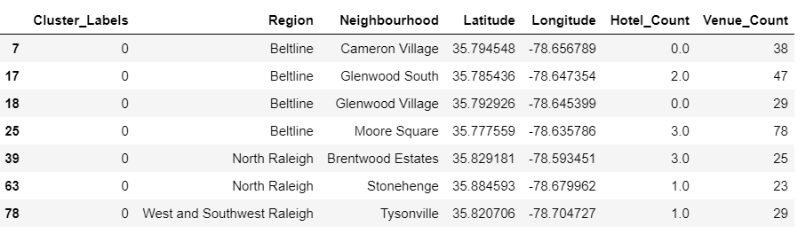
Neighborhoods in Cluster 0
Word cloud of neighborhoods gives a glimpse of the neighborhoods with maximum venues and the resulting neighborhoods.

Slide 12
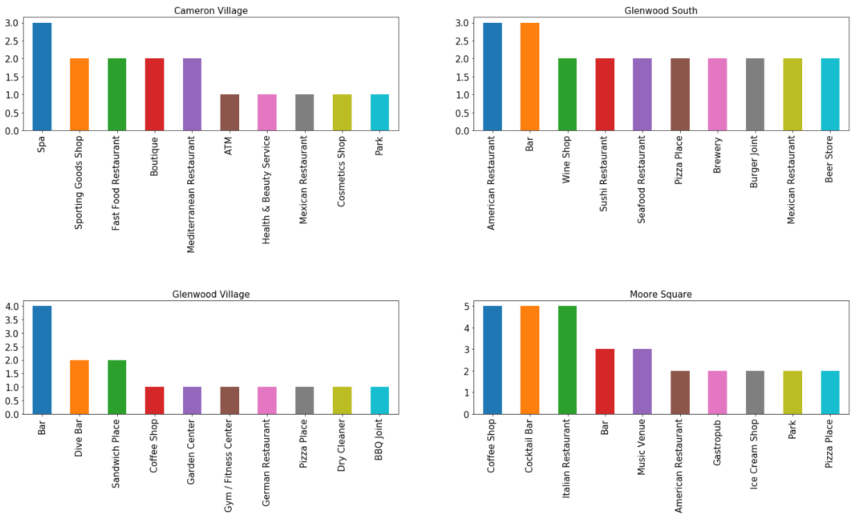
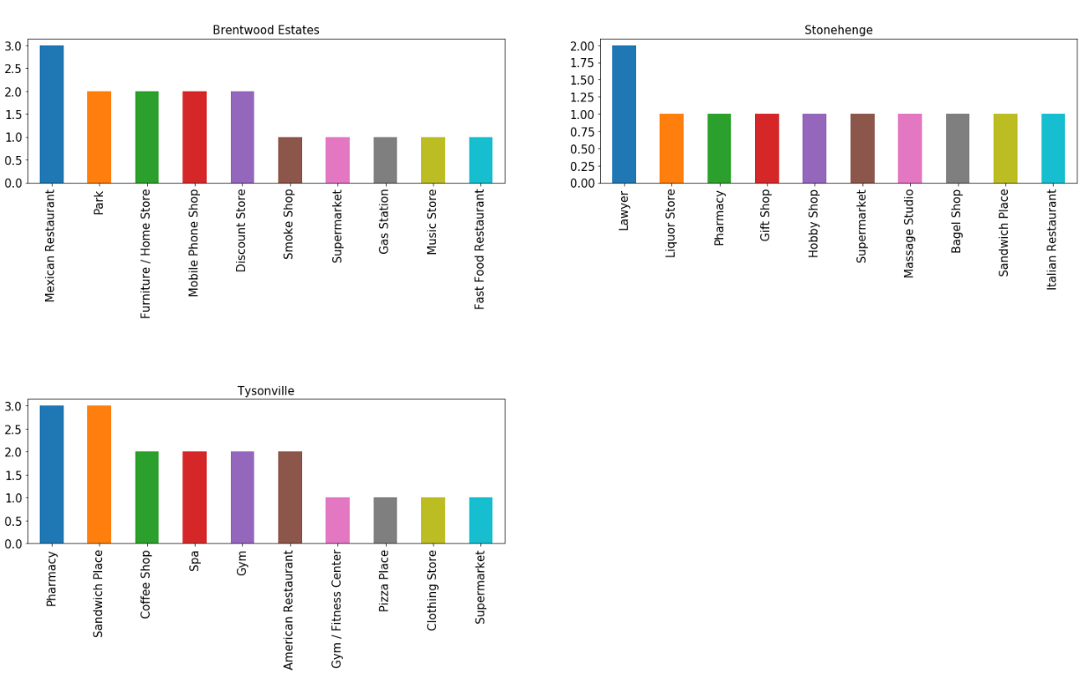
Final list of neighborhoods with the top 10 venue categories
Most of the venues in these neighborhoods are restaurants, bars etc. which are one of the things visitors look for nearby a hotel.

Slide 13
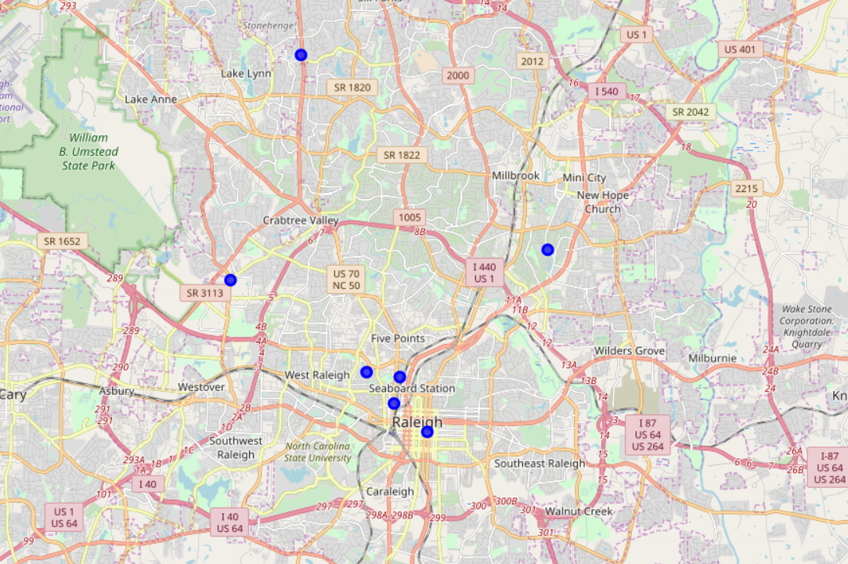
Distribution of obtained neighborhoods
The 7 neighborhoods identified have lower concentration of hotels and higher concentration of venues and they are spread out in three of the four regions in Raleigh, i.e., Beltline, north Raleigh and west-southwest Raleigh thus giving options for the choice of location of hotel near or between downtown, university or research triangle park. These neighborhoods should serve as the reference point for initiating the ground level exploration of potential hotel location.

Slide 14
Conclusion and future directions
Although it seems fit to choose downtown or the research triangle park area as the location for hotel but given their popularity, they might already be fully saturated with the hotels. Besides, as the region keeps growing, the other neighborhoods could be expected to grow and should be taken into consideration.
The list of neighborhoods and their centers could be used as a starting point for further street-level analysis of the possible locations.
There are, of course, other factors like real estate, planned projects, local community laws, hotel sales data of previous quarters, etc. which need to be considered before deciding on the final location.
A location choice gives a starting point for all further steps like capital, financial projections, etc. as well which goes in deciding the hotel development project.
This analysis can be further improved if more data related to demand, occupancy, revenue, customer surveys could be obtained for the existing hotels in the region.

